Slide 1
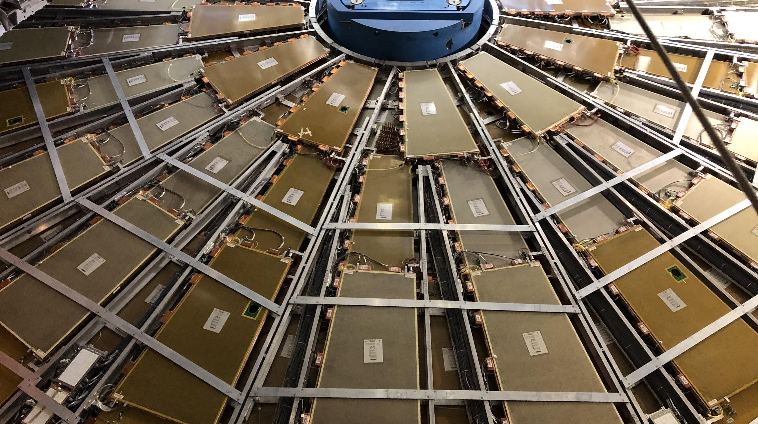

Maintenance Weekly
TileCal Op Meeting, 21 October 2021
Irakli Minashvili, Chris Thomas, Dawit Belayneh, Katie Hughes

Slide 2
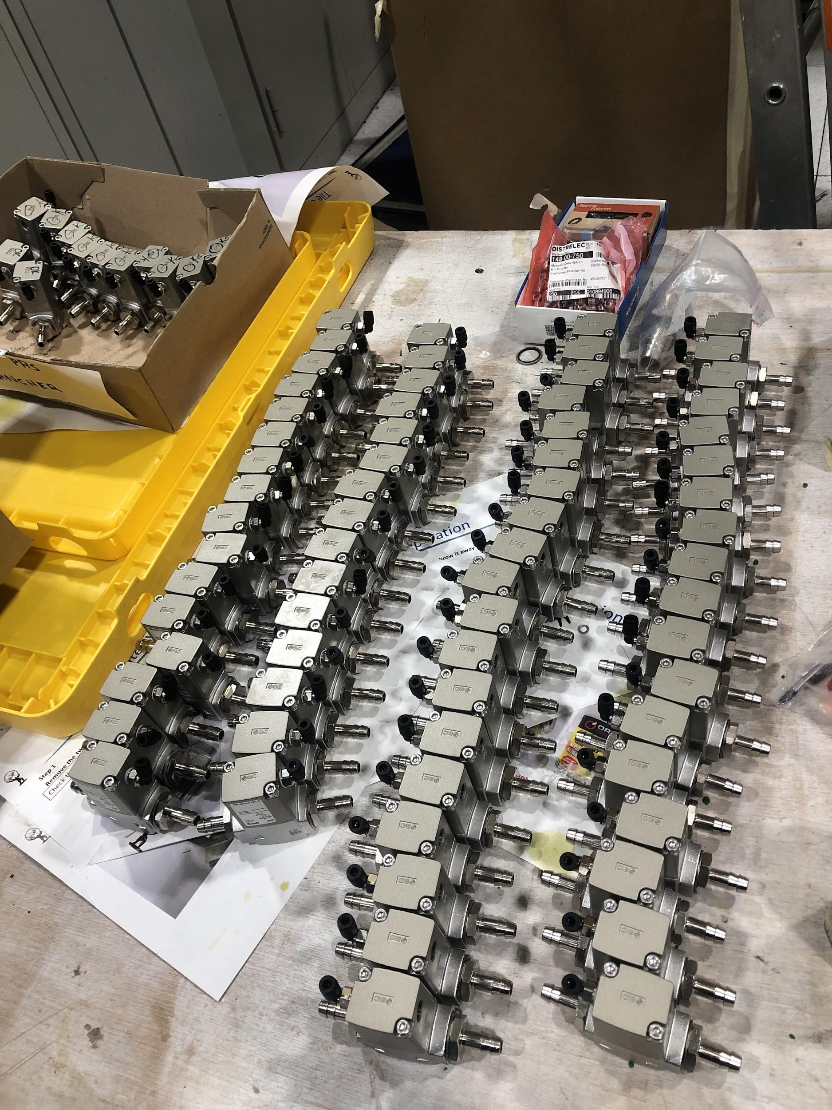
Isolation Valves Update
Will begin mounting and connecting valves on EBA Nov. 8
Still need 48 more valves
12 assembled + tested
68 assembled + not yet tested
Don’t know if we have extra boxes of valves somewhere or if they’ll need to be ordered

Slide 3
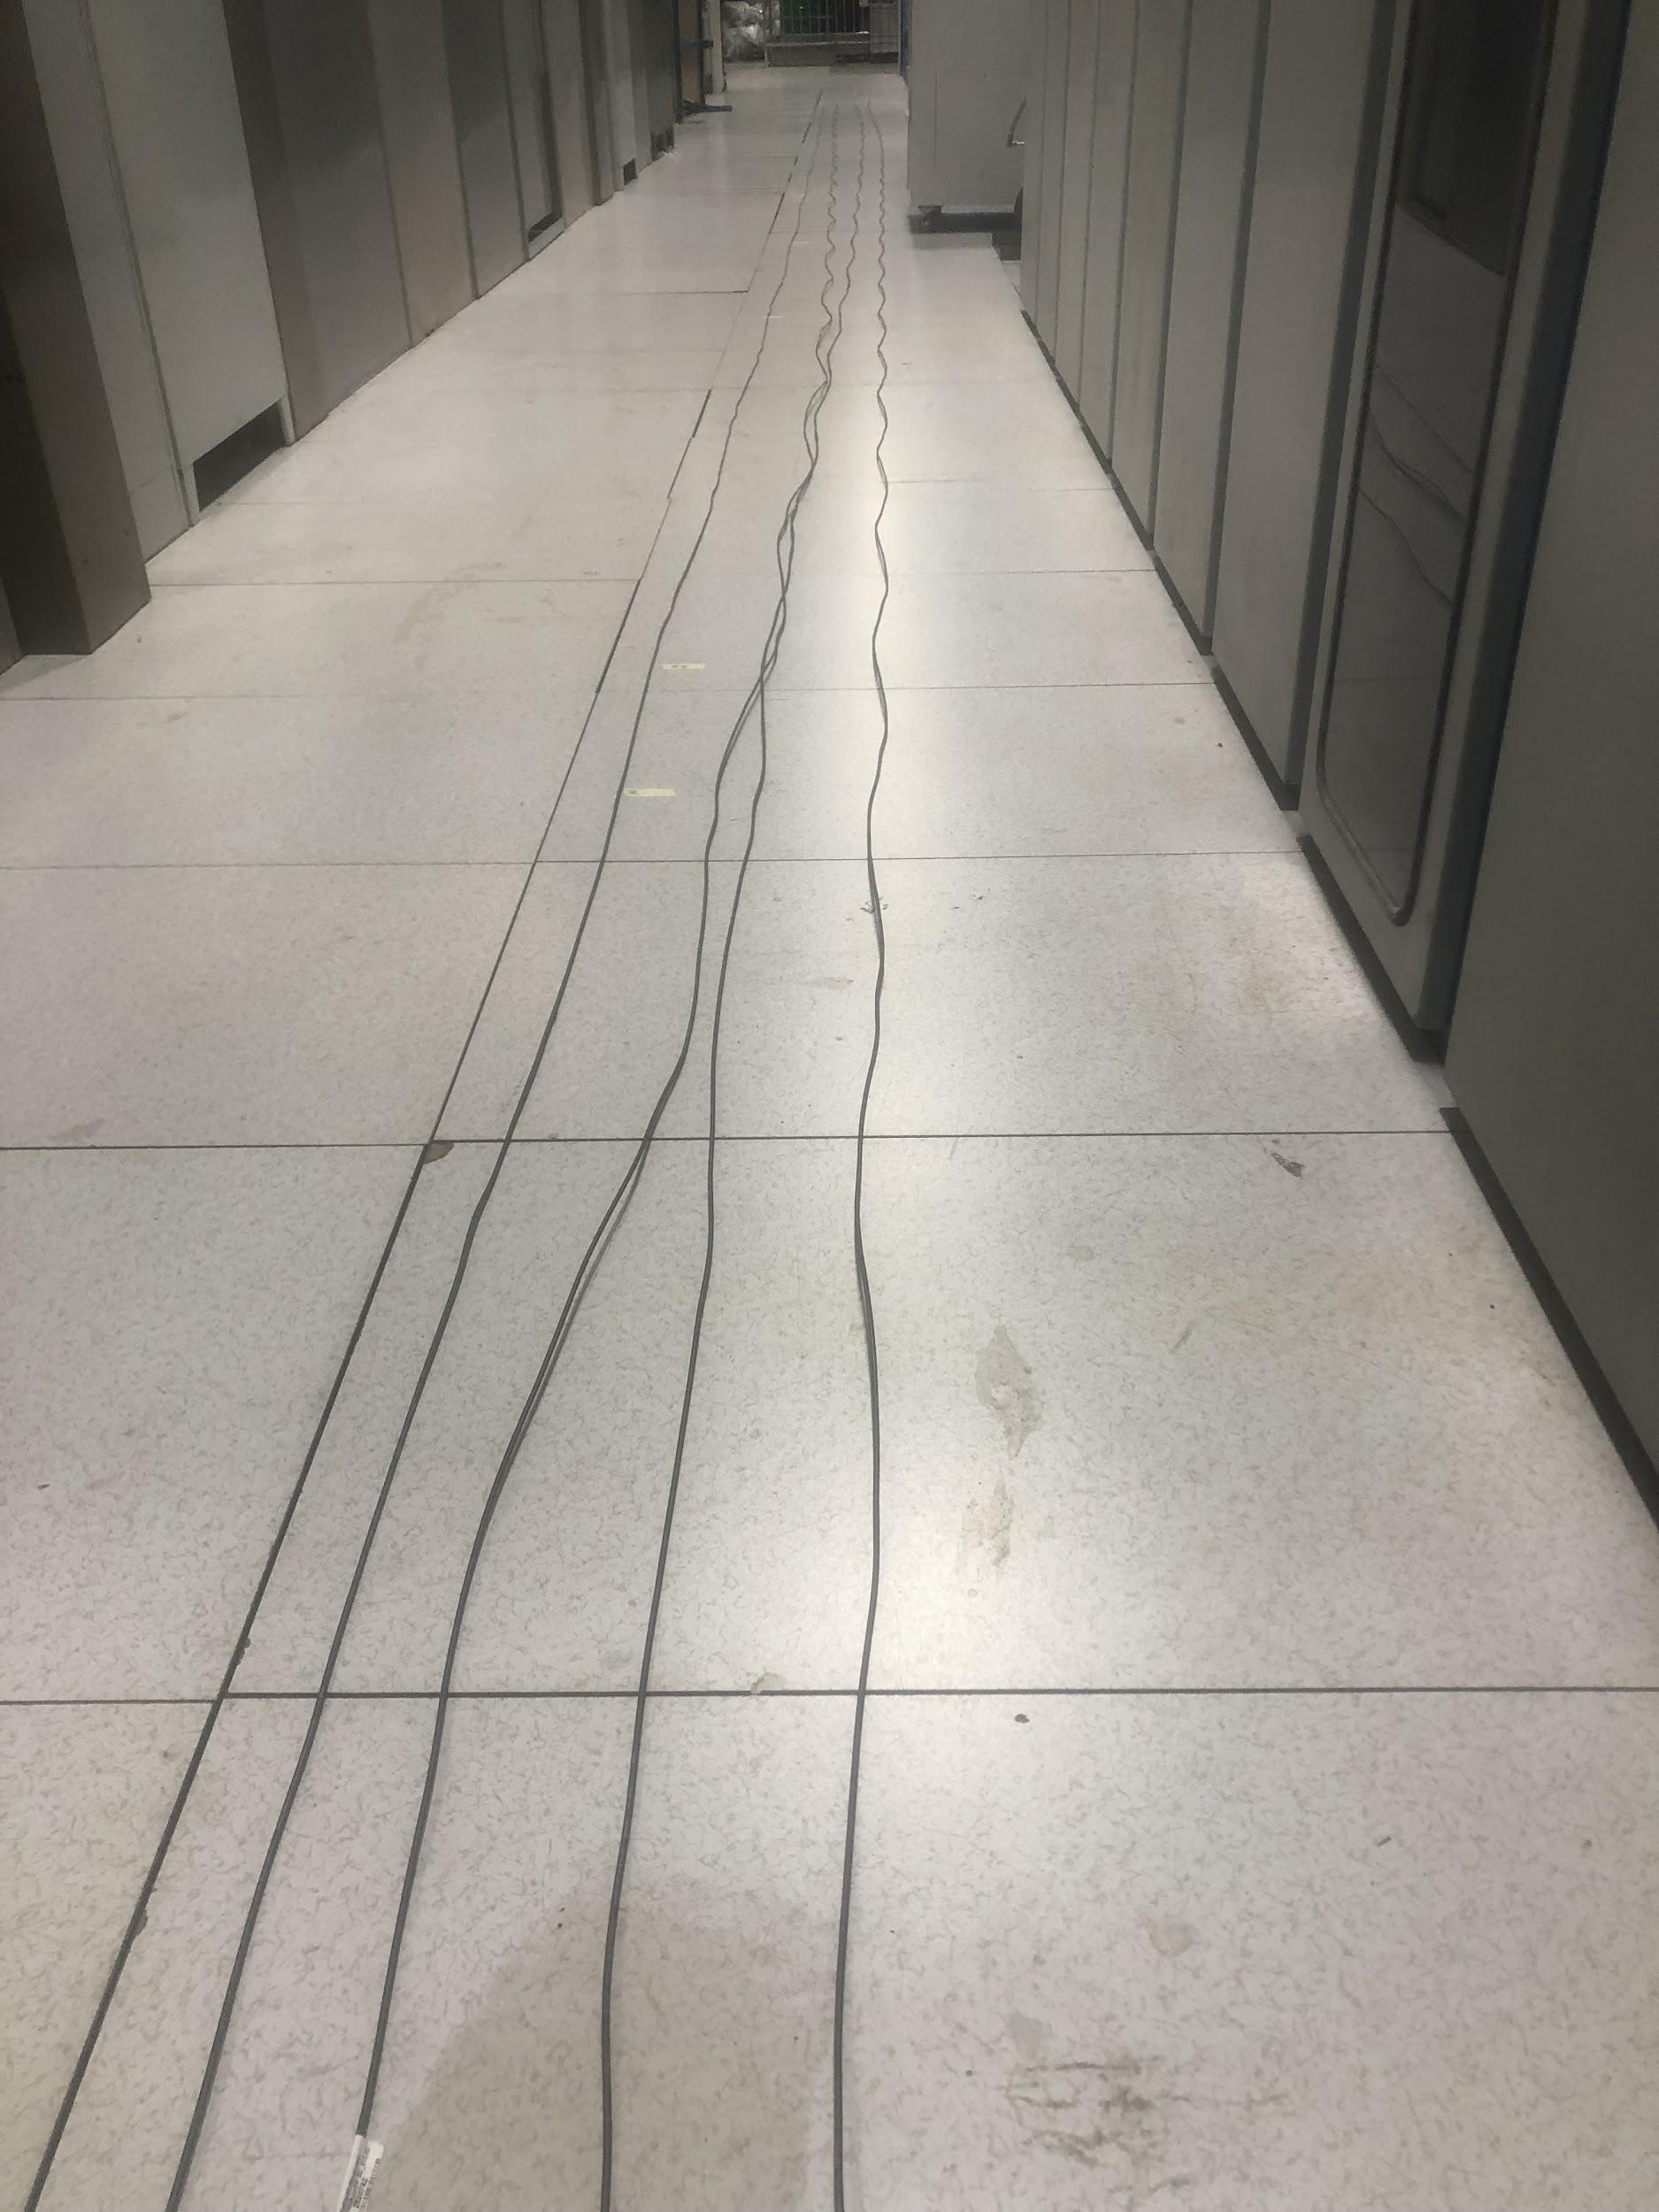
Pneumatic Pipes Update
We have been preparing the air hoses to be attached on EBC
USA side has been cut, labeled, and bundled into groups of 4
Need more hose before we can continue with the other side

